Slide 1
Econ 100 Principles of Economics
Lecture 12
March 5

Slide 2
About Today
Assignment 4 will be available on Friday till Sunday midnigt. More questions, more time, 90 minutes
Elasticity

Slide 3
Elasticity

Slide 4
Elasticity and applications
Law of demand: “The demand curve is downward-sloping. As price rises quantity demanded falls, [as price falls quantity demanded rises].”
A market: public transportation
In 1984, the City of Chicago wanted to attract more transit riders with lower fares. J. L. Shofer, research director at Northwestern University’s Transportation Center, wrote:
“Lower fares never make up for loss of revenues. Even when losing riders by increasing fares, revenue usually goes up. It’s a law of economics.”
The law of demand is too general and not useful in analyzing the case above. We often need more (precise) information.

Slide 5
Two demand curves
As P decreases from P₁ to P₂, QD increases along both demand curves Dª and D^{b}.
However, an equal decrease in price results
in a smaller increase in QD in demand curve Dª,
in a larger increase in QD for demand curve D^{b}.
Demand Curve Dª is relatively less responsive to price changes whereas Demand curve D^{b} is relatively more responsive.
P
P₁
P₂
D^{b}
Dª
Q Q₁ Q₂ Q₃

Slide 6
Price elasticity of demand
Price elasticity of demand is a measure of how much the quantity demanded of a good responds to a change in the price of that good.
Price elasticity of demand is the percentage change in quantity demanded given a percent change in the price.
If the amount of any good that people purchase changes a lot in response to a small price change, we say “DEMAND IS ELASTIC”
If a large price change results in a small change in the amount that people purchase, we say “DEMAND IS INELASTIC”

Slide 7
What makes the demand more elastic?
Demand tends to be more elastic if, …
there are close substitutes.
the market is more narrowly defined (food versus milk).
more time is allowed after the price change.
the good is a luxury. (Necessities have inelastic demand.)

Slide 8
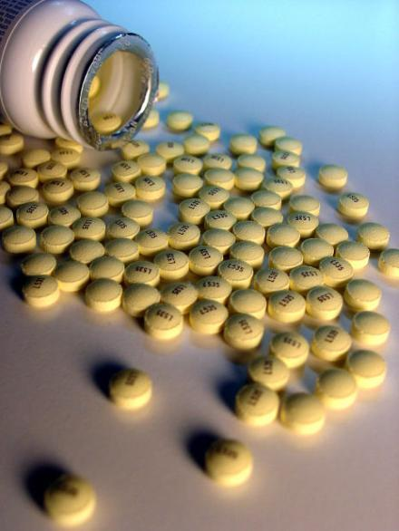
Substitutes?
The patent expires on a brand-name drug and five generic drugs come on the market.
As a result, the demand for the original drug becomes…
more price elastic
less price elastic
The demand for the original drug becomes more price elastic.

Slide 9
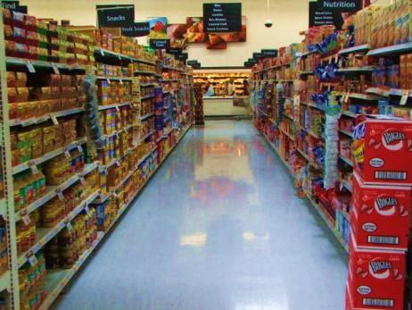
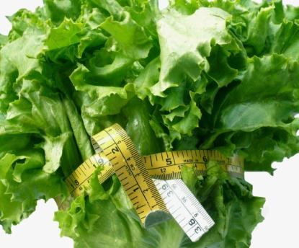
Demand for food v. demand for lettuce
The more general the classification, the fewer substitutes there are and this makes demand less elastic.
Demand for food is less price elastic than demand for lettuce.
vs.
Notes:
Instructor Notes:

Slide 10
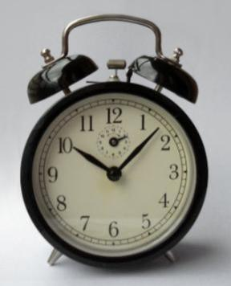
Time is on our side…
More time to adjust means higher elasticity!
Over time consumers can adjust their behavior by finding substitutes (Thus makes their demand more price elastic).
Notes:
Instructor Notes:

Slide 11
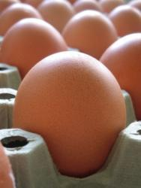

Luxuries vs. necessities
Demand for necessities is price inelastic.
Demand for luxuries is price elastic.
Notes:
Instructor Notes:

Slide 12
Price elasticity of demand
The determinants of the price elasticity of demand:
Availability of Close Substitutes
Necessities versus Luxuries
Definition of the Market
Time Horizon
Demand tends to be more elastic:
If there are a large number of close substitutes.
If the good is a luxury.
If the market is more narrowly defined (food versus milk).
If we consider a longer time period after the price change.

Slide 13
How to compute the price elasticity of demand?
The price elasticity of demand is computed as the percentage change in the quantity demanded divided by the percentage change in price.
Because the price elasticity of demand measures how much quantity demanded responds to the price, it is closely related to the slope of the demand curve.
BUT, slope is not elasticity!!

Slide 14
We will now compute the price elasticity of demand
The formula:
When the price of ice cream is ₺2, quantity demanded is 10 units (cones of ice-cream).
When the price of ice-cream is ₺2.20, quantity demanded is 8 units.
Please compute the price elasticity of demand at P = ₺2!

Slide 15
Computing the E_{P}
When P = ₺2.00, ⇒ Q_{D} = 10
When P = ₺2.20, ⇒ Q_{D} = 8
Change in Q_{D} (ΔQ_{D}) is (8 – 10) = –2.
% change in Q_{D} is –(2/10)x100 = –20%.
Change in price (ΔP) is (2.20 – 2.00) = +0.20
% change in price is (0.20/2)x100 = +10%
E_{P} = {% change in Q_{D}}/{% change in P}
E_{P} = –20/10 = –2.

Slide 16
Another one…
When the price of good X is $5, you buy 20 units. When the price is $4, you buy 23 units.
Compute the price elasticity of demand at P = $5.

Slide 17
Another one…
When the price of good X is $5, you buy 20 units. When the price is $4, you buy 23 units. Compute the price elasticity of demand at P = $5.
Solution
Change in price: (4.00 – 5.00) = -1.00
% change in price: (1.00/5.00)x100 = -20
Change in Q_{D}: (23 – 20) = 3.
% change in Q_{D} is –(3/20)x100 = 15.
E_{P} is % change in Q_{D} divided by % change in P
E_{P} = 15/-20 = –3/4.

Slide 18
What does the E_{P} number mean?
Suppose the price elasticity of demand for gasoline is -0.2.
This means:
When the price of gasoline rises by 1%, the quantity demanded falls by 0.2%
When the price of gasoline rises by 5%, the quantity demanded falls by 1%
Gasoline demand is not very price sensitive.
Notes:
Some examples.

Slide 19
What does the E_{P} number mean?
Suppose the price elasticity of demand for gold jewelry is -2.5.
This means:
When the price of gold jewelry rises by 5%, the quantity demanded falls by 12.5%.
Jewelry demand is price sensitive.
Notes:
Some examples.

Slide 20
More examples
Remember that
elasticity is a measure of the responsiveness of
quantity demanded
or
quantity supplied
to one of its determinants.
So there is also a price elasticity of supply.
Notes:
I am trying to give supply and demand about equal billing here. My text does elasticities before the detailed demand and supply discussions.

Slide 21
So, we can say things like…
Price elasticity of supply for beef is 5.
What we mean by this is that
when the price of beef increases by 1%, the quantity supplied increases by 5%.
So, beef supply is price sensitive.

Slide 22
The correct question: What is the price elasticity of demand at price Pº? (Pº is a specific price for example $28/kg –for beef)
So for example…

Slide 23
A Linear Demand Curve
Price
7
A
B
6
5
4
3
2
1
0
2
4
6
8
10
12
14
Quantity

Slide 24
The correct question: What is the price elasticity of demand at price Pº? (Pº is a specific price for example $28/kg –for beef)
P^{O} = Current price of good X
Q^{O} = Quantity demanded at that price
ΔP = a small change in the current price
ΔQ = the resulting change in quantity demanded

Slide 25
A little bit of mathematics
Take the formula
Rearrange the formula

Slide 26
What is this ? (It is related to the slope of the demand curve.)
Price decreases from P₁ to P₂.
ΔP = (P₂–P₁) = the change in price. (ΔP < 0)
Quantity demanded increases from Q₁ to Q₂.
ΔQ = (Q₂–Q₁) = the change in quantity demanded.
slope = ΔP/ΔQ
1/slope = ΔQ/ΔP
Elasticity E_{P} = (1/slope)x(P/Q)
Price
Demand
P₁
ΔP
P₂
ΔQ
Q₁
Q₂
Quantity

Slide 27
A Linear Demand Curve
Price
7
Elasticity is larger than 1.
6
5
4
Elasticity is smaller than 1.
3
2
1
0
2
4
6
8
10
12
14
Quantity

Slide 28
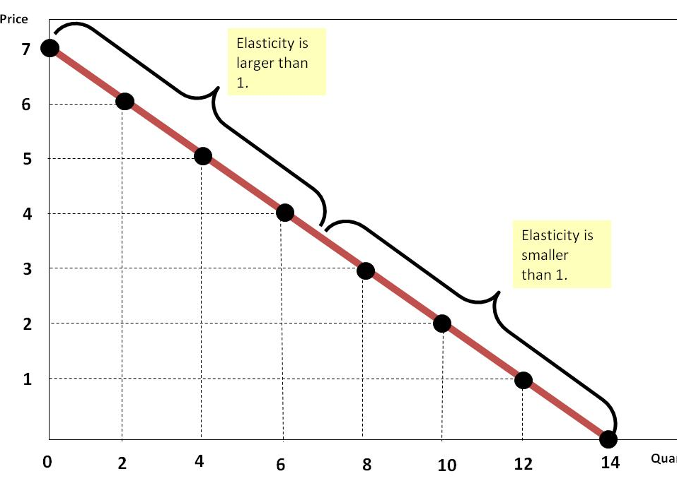
which we also write as E_{P} = [1/slope]x(P/Q)
Slope = ‒½
1/slope = ‒2
E_{P} at P = 6 is
‒2x(6/2) = ‒6
E_{P} at P = 3.5 is
‒2x(3.5/7) = ‒1
E_{P} at P = 1 is
‒2x(1/12) = ‒1/6

Slide 29
Elastic versus inelastic demand curves
Roughly,
Inelastic Demand
Quantity demanded does not respond strongly to price changes.
Price elasticity of demand is less than one.
Elastic Demand
Quantity demanded responds strongly to changes in price.
Price elasticity of demand is greater than one.
Formally,
If | E_{P} | > 1, demand is (price) elastic.
If | E_{P} | < 1, demand is (price) inelastic.
If | E_{P} | = 1, demand is (price) unit elastic.
A very important remark: Because price and quantity are negatively related along the (typical) demand curve, E_{P} is (always) negative.

Slide 30
Some real price elasticity numbers
On average, in the United States, a 10% increase in the price of water can be expected to diminish demand in the urban residential sector by about 3 to 4 %.
This is equivalent to saying that U.S. residential water price elasticity E_{P} is in the range of –0.3 to –0.4.

Slide 31
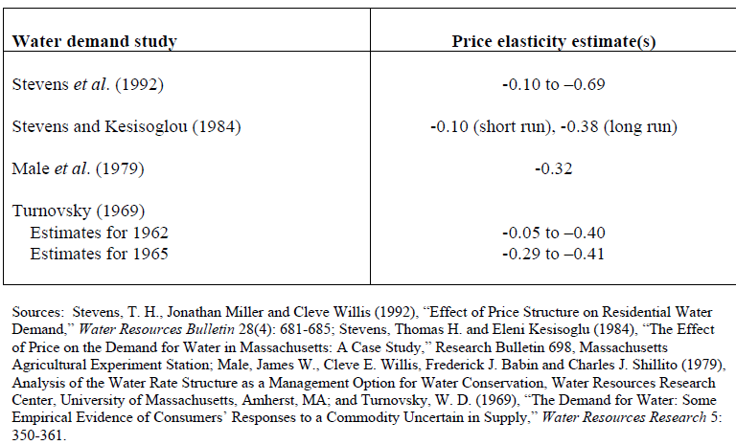
Price Elasticity Estimates in New England

Slide 32
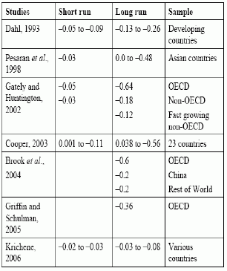
Oil price demand elasticity
More recent numbers collected from scientific studies by the Bank of England (6/2008)
Price elasticity is close to zero in short term.
It increases with time, but remains low.
www.theoildrum.com/node/4397

Slide 33
Remark on elasticity calculation
Elasticity calculation can be tricky, because there are many (simultaneous) influences on demand and supply. (See the example below.) Consider a demand curve drawn on the P­ vs. Q graph. E_{P} is a measure that corresponds to movements up and down the demand curve. But changes in other variables (shown as shifts in the P vs. Q graph) also impact price and quantity. To calculate E_{P} correctly, we have to make sure that all else is held constant.

Slide 34
Remark on elasticity calculation
The following data show the prices of X and Y, the annual income of the consumer, and the quantities of X consumed during the last 6 years.
(a) Which pair of years would you use to calculate the price elasticity of demand for X? Why?
(b) What is the price elasticity of demand for X?
Year | P_{X} ($) | Q_{X} | P_{Y} ($) | Income ($)
1987 | 100 | 80 | 50 | 20,000
1988 | 110 | 90 | 40 | 18,000
1989 | 90 | 100 | 40 | 18,000
1990 | 100 | 100 | 60 | 20,000
1991 | 100 | 90 | 40 | 20,000
1992 | 100 | 110 | 40 | 25,000

Slide 35
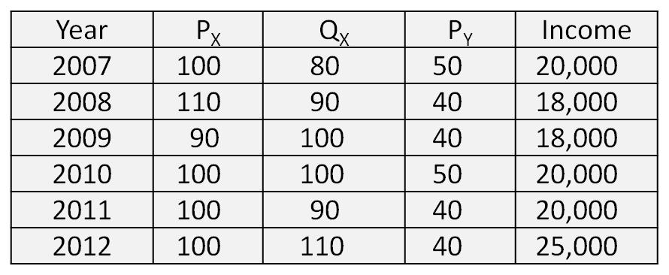
Solution
Choose 2008 and 2009
Why?
Because P_{y} and Income are constant in those two years.
In 2008 : P = 110, Q = 90
In 2009 : P = 90, Q = 100

Slide 36
Solution
In 2008 : P = 110, Q = 90
In 2009 : P = 90, Q = 100
The percentage change in Q is +11.1% (100–90)/90
The percentage change in P is –18.2% (90–110)/110
E_{P} = % change in Q divided by % change in P
E_{P} = –11.1/18.2 = –0.61 (inelastic)
E_{P} = –0.61 at P = 110.

Slide 37
Solution
In 2008 : P = 110, Q = 90
In 2009 : P = 90, Q = 100
We can also ask: What is the price elasticity of demand at P = 90?
The percentage change in Q is –10% (90–100)/100
The percentage change in P is +22.2% (110–90)/90
E_{P} = % change in Q divided by % change in P
E_{P} = –10/22.2 = –0.45 (inelastic)
E_{P} = –0.45 at P = 90.

Slide 38
In 2008: P = 110, Q = 90
In 2009: P = 90, Q = 100
Change in P is 20, change in Q is 10
If P = 110 and Q = 90 is used then E = 0.61
If P = 90 and Q = 100 is used then E = 0.45
The book suggest we should use the midpoint Q and midpoint P: P = 100 and Q = 95
You would get E = 0.50

Slide 39
In Greg Mankiw’s words…
The Midpoint Method is a better way to calculate percentage changes and elasticities.
The midpoint formula is preferable when calculating the price elasticity of demand because it gives the same answer regardless of the direction of the change.

Slide 40
Particular demand curves
Perfectly Inelastic
Quantity demanded does not respond to price changes.
Perfectly Elastic
Quantity demanded changes infinitely with any change in price.
Unit Elastic
Quantity demanded changes by the same percentage as the price.

Slide 41
Perfectly Inelastic Demand
Price
Demand
E = 0
$5.00
$4.00
1. An increase in price…
0
100
Quantity
2. …leaves the quantity demanded unchanged.

Slide 42
Inelastic Demand
Price
Demand
E < 1
$5.00
$4.00
1. A 22% increase in price…
0
90
100
Quantity
2. … Leads to a 11% decrease in quantity demanded.

Slide 43
Unit Elastic Demand
Price
E = 1
Demand
$5.00
$4.00
1. A 22% increase in price…
0
80
100
Quantity
2. … Leads to a 22% decrease in quantity demanded.

Slide 44
Elastic Demand
Price
E > 1
Demand
$5.00
$4.00
1. A 22% increase in price…
0
50
100
Quantity
2. … Leads to a 67% decrease in quantity demanded.

Slide 45
Perfectly Elastic Demand
Price
E = ∞
1. At any price above $4, quantity demanded is zero.
$4.00
Demand
2. At exactly $4, consumers will buy any quantity.
3. At any price below $4, quantity demanded is infinite.
0
Quantity

Slide 46
Self test #1
Which of these demand curves is more price elastic at P = P₀?

Slide 47
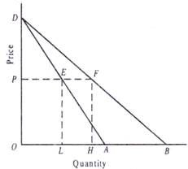
Which demand curves is more price elastic at P = P₀?
P₀

Slide 48
Self test #2
Which of these demand curves is more price elastic at P = P₀?

Slide 49
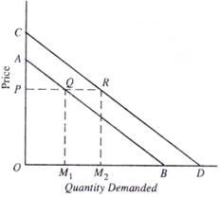
Which demand curves is more price elastic at P = P₀?
P₀

